Slide 1

Vel Tech Rangarajan Dr. Sagunthala R&D Institute of Science and Technology
School of Computing
Department of Computer Science and Engineering
10211CS224 / FULL STACK APPLICATION DEVELOPMENT (JAVA)
END SEMESTER PROJECT REVIEW
Date: 06-05-2026
WEB-BASED JOB PORTAL MANAGEMENT SYSTEM
SDG:SDG 8: DECENT WORK AND ECONOMIC GROWTH
Presented By:
A.Naga Vinay Gopi – VTU25557– 23UECS0648
Courses Handling Faculty:
Dr. S. Hemamalini – M.E., Ph.D.

Slide 2
INTRODUCTION
Job Portal Management System is a web-based platform that connects employers and job seekers (students/users) in a centralized environment.
It simplifies the recruitment process by allowing employers to post job vacancies and manage applications efficiently.
Job seekers can browse available jobs, upload or update resumes, and apply for suitable positions
The system provides features like shortlisting candidates, making hiring faster and more organized.
It reduces the need for manual recruitment processes and improves communication between employers and applicants.
The platform ensures easy access to job opportunities anytime and anywhere.
It enhances transparency, reduces hiring time, and improves overall efficiency in the recruitment process.
This system supports employment growth and aligns with SDG 8: Decent Work and Economic Growth by promoting job accessibility.
1
2
3
4
5
6
7
8
9

Slide 3
PROBLEM STATEMENT
1
In today’s competitive job market, students and job seekers often struggle to find relevant job opportunities in a timely manner, while employers face difficulty in identifying suitable candidates efficiently. The existing recruitment processes are often fragmented, time-consuming, and lack a centralized platform for seamless interaction between job providers and applicants.
To address these challenges, a Job Portal Management System is required to provide an
integrated solution where employers can host job openings and shortlist candidates, and students/job seekers can browse jobs, upload or update resumes, and apply for suitable positions. The system aims to streamline the recruitment process by enabling easy communication, efficient candidate management, and quick access to opportunities.
2
3
4
5
6
7
8
9

Slide 4
OBJECTIVE(S)
1
Centralized Web Platform: A single, unified hub connecting job seekers and employers directly.
Role-Based Access Control: Dedicated, secure dashboards for Students, Employers, and Admins.
Modern & Responsive UI: Built with React.js using an engaging, high-contrast Neo-Brutalist design.
Automated Tracking: Replaces messy email applications with real-time status updates (Pending, Shortlisted, Rejected).
High Security: Implements Spring Security & JWT for stateless, secure authentication and data protection.
Scalable Architecture: RESTful APIs using Spring Boot and MySQL allow for fast data retrieval and future expansion.
Streamlined Hiring Workflow: Enables digital resume uploads, advanced job filtering, and instant applicant reviews.
2
3
4
5
6
7
8
9

Slide 5
PROPOSED SYSTEM
Full-Stack Architecture : A web application using Spring Boot and React to connect employers and job seekers efficiently.
Unified Recruitment Workflow : Combines job posting, applicant tracking, shortlisting, and resume management in one system.
AI-Powered Employer Tools : Provides an AI-based question generator for creating role-specific technical assessments.
Eliminates Hiring Fragmentation : Centralizes recruitment processes to reduce scattered workflows and improve organization.
Resolves Communication Delays : Offers real-time updates and automated notifications for better user communication.
Superior Modern UI/UX : Uses a responsive Neo-Brutalist design for a clean and engaging user experience. Distinct Role-Based Dashboards : Provides separate dashboards for students and employers for better usability. Secure and Scalable Ecosystem : Uses JWT authentication and admin controls to ensure security and scalability.
1
2
3
4
5
6
7
8
9

Slide 6
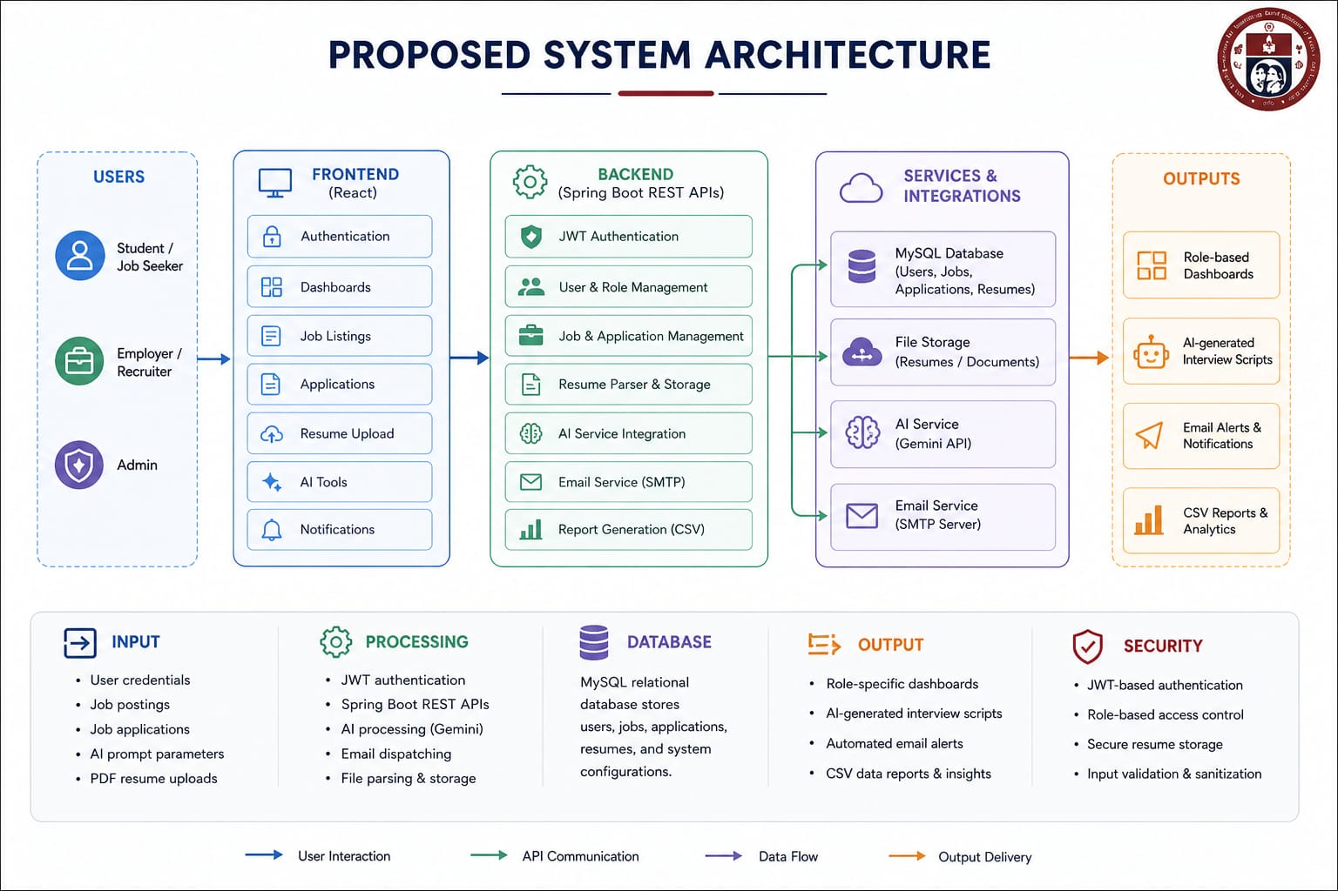
PROPOSED SYSTEM ARCHITECTURE
1
2
3
4
5
6
7
8
Input: User credentials, job postings, job applications, AI prompt parameters, and PDF resume uploads.
Processing: JWT authentication, Spring Boot REST APIs, SMTP email dispatching, and Gemini AI data handling.
Database: MySQL relational database storing user profiles, job listings, application tracking data, and resume file paths.
Output: Role-specific Neo-Brutalist dashboards, AI-generated interview scripts, automated email alerts, and CSV data reports.
9

Slide 7
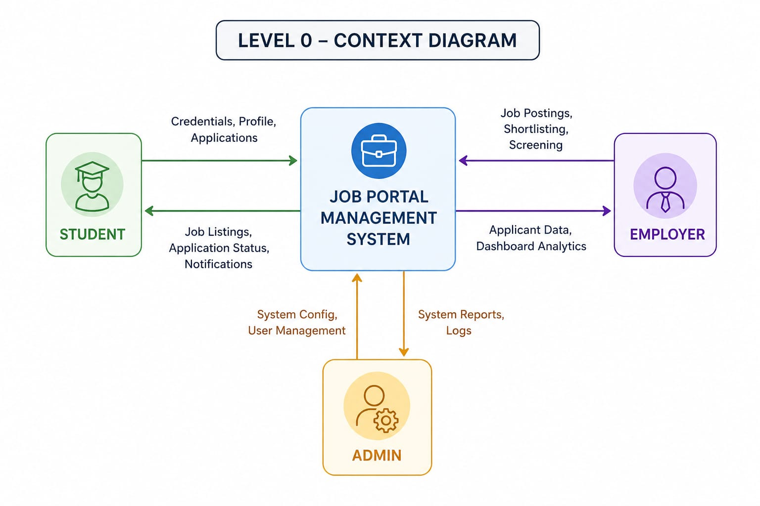
WORKFLOW
1
2
3
4
5
6
7
Centralized System: All user activities are handled through a single job portal system, avoiding scattered processes.
Bidirectional Data Flow: Data flows both ways—users send requests and receive responses from the system. Role-Based Interaction: Each user (student, employer, admin) interacts differently based on their role and needs. Efficient Processing: The system processes requests quickly and provides real-time updates.
Simplified Overview: The Level 0 DFD gives a high-level view without showing internal details of the system.
8
9

Slide 8
TECHNOLOGIES USED
Frontend : HTML , CSS , JavaScript
Backend : Java , Spring Boot , Spring MVC
Database : MySQL
Third-Party APIs : SMTP services using Gmail are used for sending automated emails and OTP verification.
Tools : Visual Studio Code
Hardware/Software Requirements: Windows, Web Browser
1
2
3
4
5
6
7
8
9

Slide 9
MODULE DESCRIPTION
Module 1: Authentication & User Management : Handles role-based registration for Students, Employers, and Admins with secure login using JWT-based authentication via Spring Security. It also supports profile management and role-specific access control to ensure data security and personalized user experience.
Module 2: Job & Application Processing : Implements the core recruitment workflow, enabling employers to create, update, and manage job listings efficiently. Students can apply for jobs, upload resumes, and track application status in real time through an integrated system.
Module 3: Database & File Management : Manages structured storage of users, jobs, and application data using MySQL for consistency and reliability. It also ensures secure upload, storage, and retrieval of resume files with proper data handling mechanisms.
Module 4: Innovative Integrations (AI & Alerts) : Integrates the Google Gemini API to generate dynamic, role-specific interview questions for employers. Uses SMTP-based email services for automated notifications, alerts, and OTP verification to enhance communication.
Module 5: Dashboards & Reporting : Provides role-based dashboards with a modern Neo-Brutalist UI for students, employers, and admins. It offers real-time updates, candidate shortlisting views, and data export features (CSV) for better analysis and decision-making.
1
2
3
4
5
6
7
8
9

Slide 10
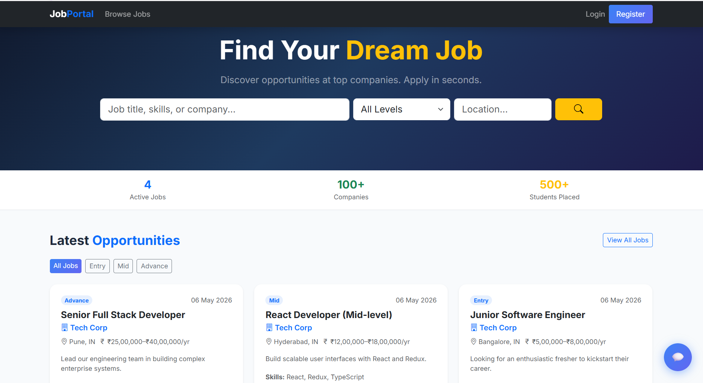
IMPLEMENTATION SCREENSHOTS
1
2
3
4
5
6
7
8
The above screenshot represents the home page of our job portal management system, where the users can navigate to different webpages.
9

Slide 11
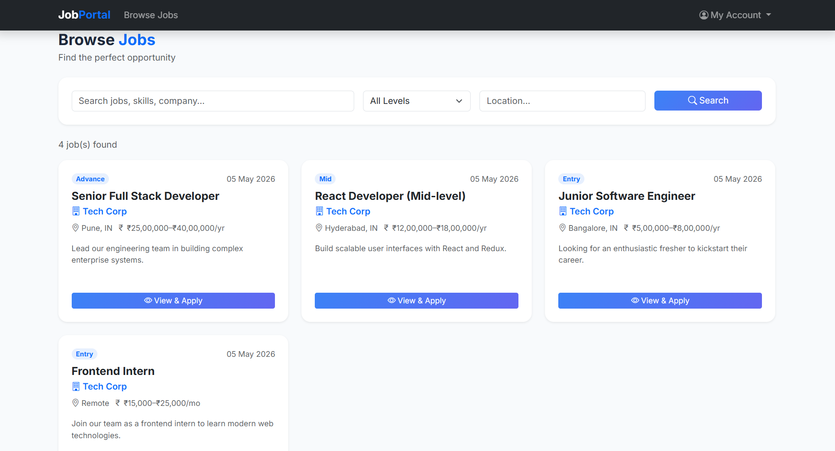
IMPLEMENTATION SCREENSHOTS
1
2
3
4
5
6
7
8(A)
The above screenshot represents the trending jobs and jobs which are recently posted in the home page of out job portal management system.
9

Slide 12
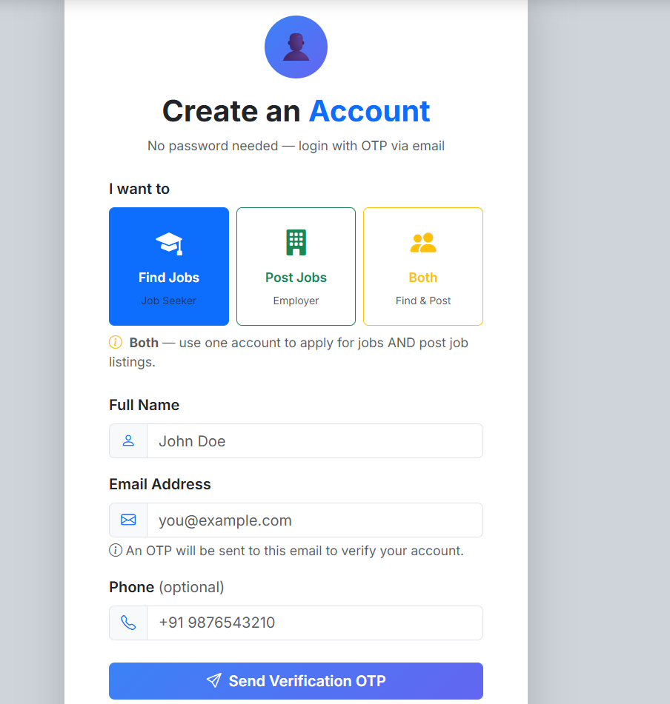
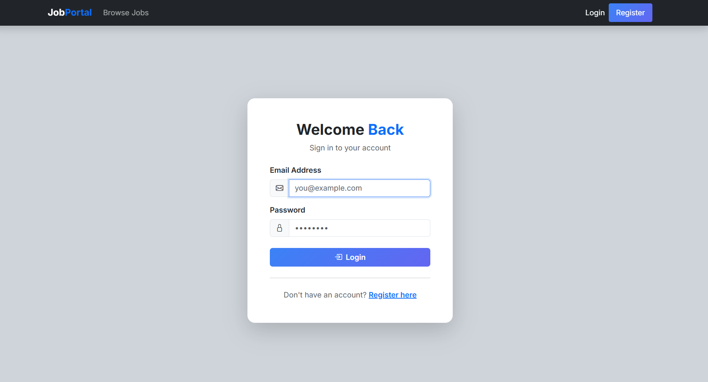
IMPLEMENTATION SCREENSHOTS
1
User Login Page
Admin Login Page
2
3
4
5
6
7
8(B)
9

Slide 13
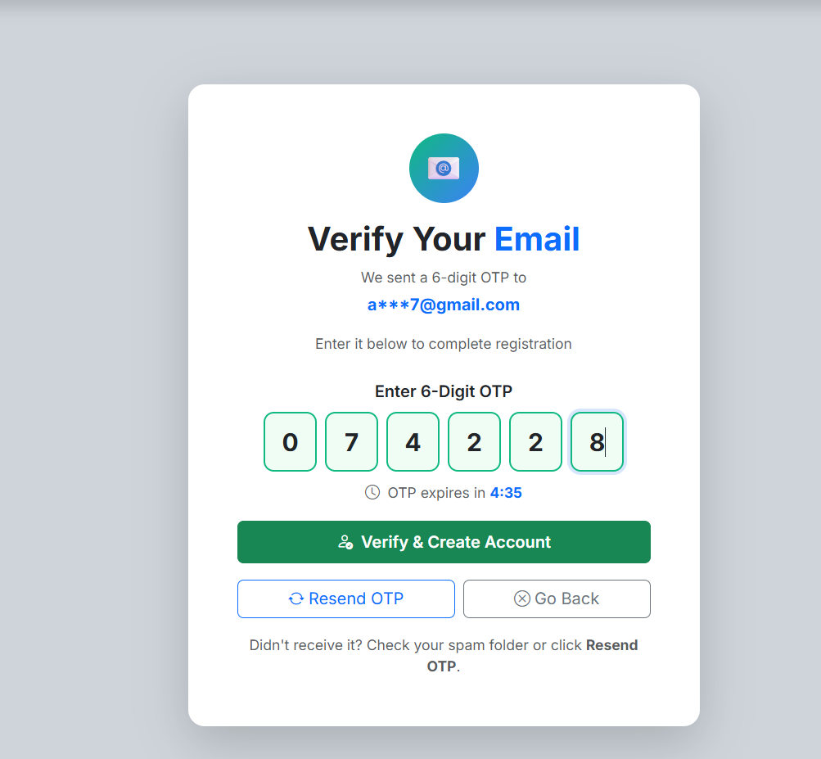
IMPLEMENTATION SCREENSHOTS
1
2
3
4
5
6
7
8(C)
9
The above screenshot represents the module 1 i.e. the user Authentication & Management Module.

Slide 14
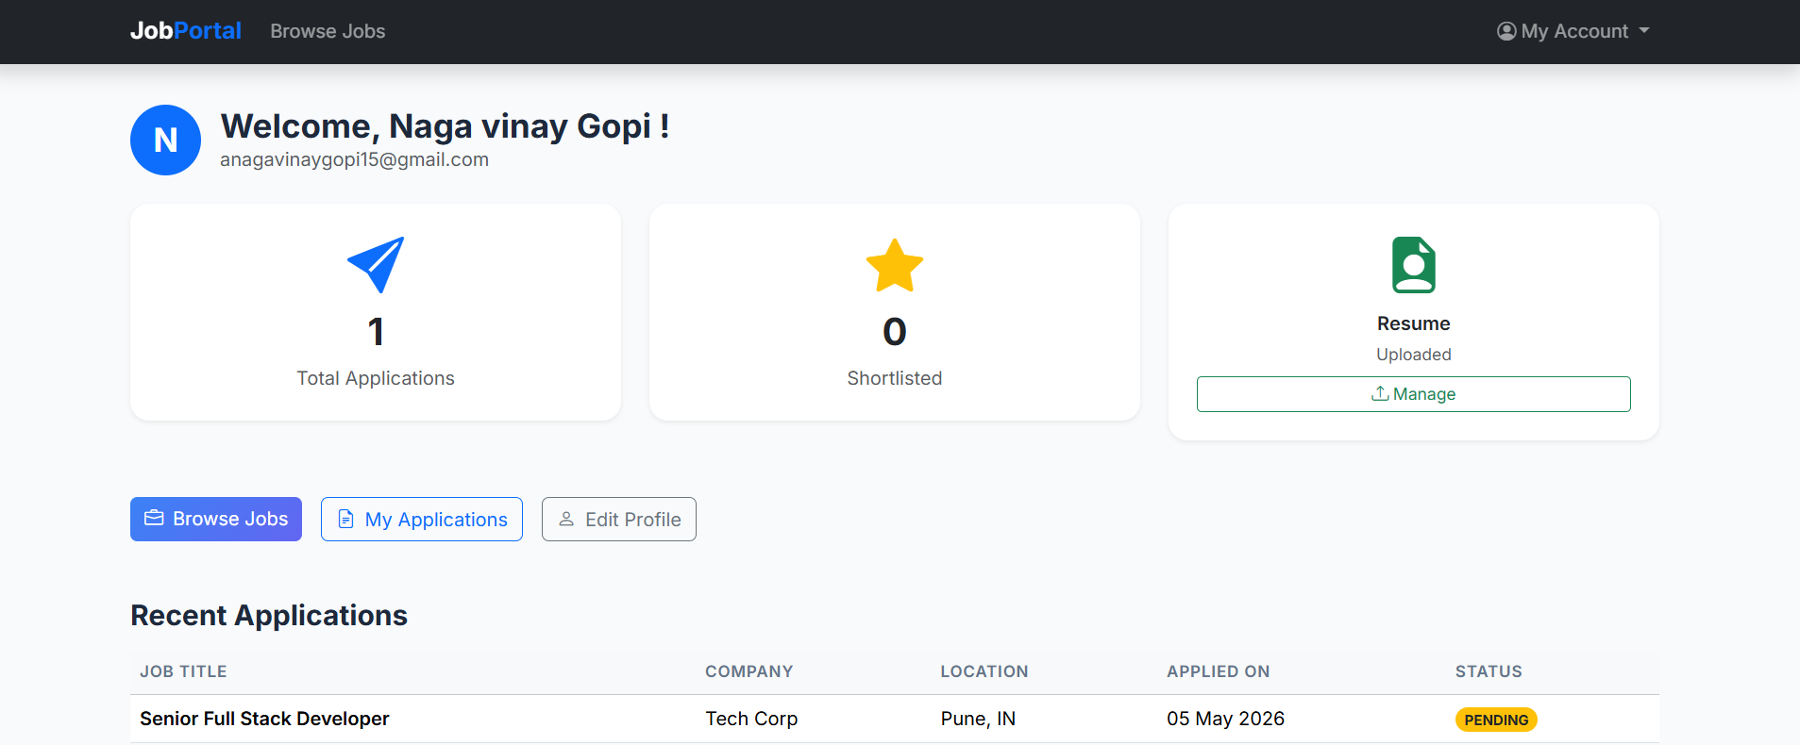
IMPLEMENTATION SCREENSHOTS
1
2
3
4
5
6
7
8(C)
9
The above screenshot represents the Module 2 i.e. Job & Application Processing Module.

Slide 15
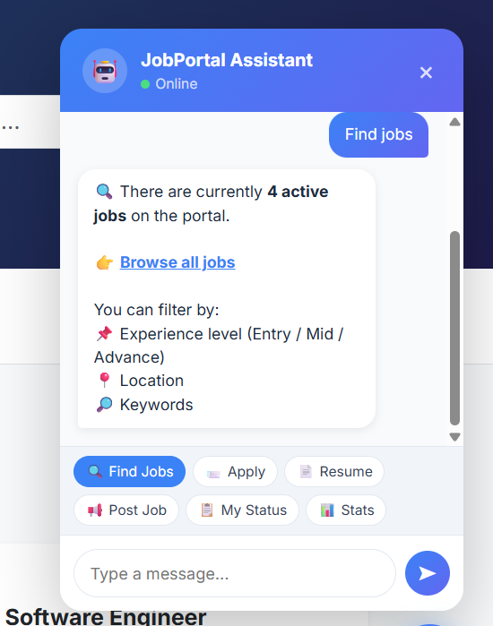
IMPLEMENTATION SCREENSHOTS
1
2
3
4
5
6
7
8(C)
The above screenshots refers the innovative module chatbot.
9

Slide 16
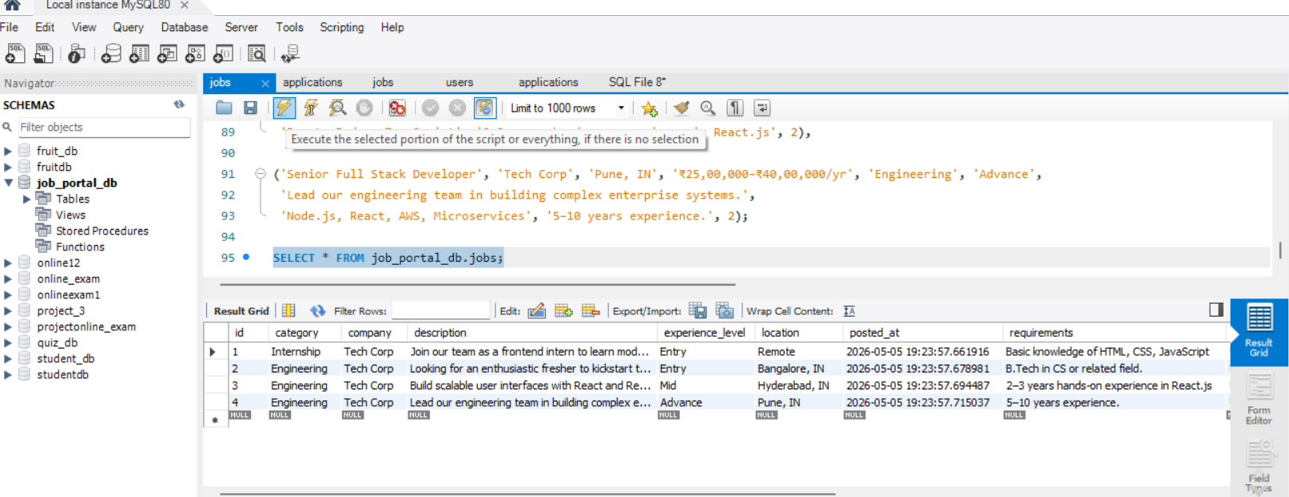
IMPLEMENTATION SCREENSHOTS
1
2
3
4
5
6
7
8(C)
9

Slide 17
ADVANTAGES & LIMITATIONS
Advantages Unified Workflow : Centralizes job posting, applications, and resume management in one platform.
AI Productivity : Uses Google Gemini API to generate role-specific interview questions instantly.
Modern UI/UX : Neo-Brutalist design with role-based dashboards for a clean, engaging experience.
Automated Communication : SMTP-based emails provide instant updates and OTP verification.
Strong Security : Spring Security with JWT ensures secure authentication and role-based access.
1
2
3
4
5
6
7
8
Limitations
API Dependency : Relies on external services like Gemini API and SMTP, which may fail during downtime or limits.
AI Accuracy : Generated questions may sometimes be complex or slightly inaccurate, requiring manual review.
9

Slide 18
Thank you

